Slide 1
Colonial Coal International Corporation
TSX-V: CAD
Western Canada’s Leading Coking Coal Developer
December 2016 Investor Presentation

Slide 2
Legal Disclaimers
This presentation may contain forward-looking statements, and forward -looking information under applicable securities laws including management’s expectations of future production, cash flow, and earnings. These statements are based on current expectations that involve a number of risks and uncertainties, which could cause actual results to differ from those anticipated. These risks and uncertainties include, but are not limited to: the risks associated with the commodity industry (e.g. operational risks in development, exploration and production; delays or changes in plans with respect to exploration or development projects or capital expenditures; the uncertainty of reserve estimates; the uncertainty of estimates and projections relating to production, costs and expenses, and health, safety and environmental risks), commodity price, price and exchange rate fluctuation and uncertainties resulting from potential delays or changes in plans with respect to exploration or development projects or capital expenditures.
There can be no assurance that forward-looking statements will prove to be accurate, as actual results and future events could differ materially from those anticipated in such statements. Colonial Coal undertakes no duty to update any of the forward-looking information herein. The reader is cautioned not to place undue reliance on forward-looking statements.
The scientific and technical information relating to the Huguenot property has been derived from the Huguenot Technical Report dated September 23, 2013, a copy of which will be filed on sedar.com under Colonial Coal International Corp., copies of the technical report will be made available to investors on request.
The information contained in this document has not been reviewed or approved by the U.S. Securities and Exchange Commission or any provincial or state securities regulatory authority. Any representation to the contrary is unlawful. This document does not include a complete description of Colonial Coal or any offering. Any offer of securities Colonial Coal will be made only pursuant to a subscription agreement and the provisions of applicable law. Any securities to be offered for sale by Colonial Coal are not expected to be registered in the United States under the Securities Act or under any state securities laws.
Cautionary Note to US Investors Concerning Resource Estimate:
The resource estimates in this document were prepared in accordance with National Instrument 43-101, adopted by the Canadian Securities Administrators. The requirements of National Instrument 43-101 differ significantly from the requirements of the United States Securities and Exchange Commission (the “SEC”). In this document, we use the terms “measured,” “indicated”, and “inferred” resources. Although these terms are required and recognized in Canada, the SEC does not recognize them. The SEC permits US mining companies, in their filings with the SEC, to disclose only those mineral deposits that constitute “reserves.” Under United States standards, mineralization may not be classified as a reserve unless the determination has been made that the mineralization could be economically and legally extracted at the time the determination is made. United States investors should not assume that all or any portion of a measured or indicated resource will ever be converted into “reserves”. Further, “inferred resources” have a great amount of uncertainty as to their existence and whether they can be mined economically or legally, and United States investors should not assume that “inferred resources” exist or can be legally or economically mined, or that they will ever be upgraded to a higher category.

Slide 3
Market Overview: Metallurgical Coal
Company Overview: Colonial Coal
Summary: Investment Highlights

Slide 4
Met Coal Price Rally of 2016
Market Overview: Metallurgical Coal
Seaborne Hard Coking Coal Price Chart (US$/mt)
Market Commentary
  The met coal price rally has broken a 5-year downturn as prices surged by more than 120% this year
  The rally was triggered by Beijing’s decision to reduce coal miner operating days from 330 to 276 in an effort to restructure the industry
  In addition, weather-related problems in China and Australia have caused disruptions to local mines and railways
  These factors have led China to rely more on foreign coal supply
  China imported 24.3 million tonnes of coal in September 2016, up more than 33% compared to September 2015.
  Over the first 9 months of 2016, imports increased 15% to 180 million tonnes compared to the same period in 2015
  Outside of China, macro strategists are anticipating sequentially stronger growth in 2017 and 2018
  President-elect Donald Trump is expected to pursue a pro-growth agenda via broad adoption of infrastructure-friendly fiscal stimulus
Coking coal prices up +120% since January 2016

Slide 5
Market Overview: Metallurgical Coal
Canadian coking coal miners are strategically positioned to supply Chinese excess demand…

Slide 6
Western Canadian Coal Miners are Poised to Supply Asian Markets
Market Overview: Metallurgical Coal
Canadian Met Coal Supply by Project
Western Canadian Coal Overview
Western Canada has vast coal resources including some of the world’s highest quality metallurgical coals
  ~21 Mt of met coal exports in 2012
  ~26 Mt of met coal exports in 2015
The region enjoys access to low-cost power, high-quality road and rail networks and major deep water seaports
British Columbian ports provide the closest port of entry on the west coast of North America to Asia
Western Canada has seen significant M&A activities in the met coal market.
  Walter Energy acquires Western Coal - $3.3bn
  Anglo American acquires 25% of Peace River Coal held by NEMI and Hillsborough - $166mm ($400m+)
  Xstrata⁽¹⁾ acquires First Coal and Lossan - $193mm
  Winsway and Marubeni jointly acquire Grande Cache Coal -$1bn
  Xstrata⁽¹⁾ acquires Sukunka asset from Talisman Energy - $500mm
  JX Nippon acquires 25% in Xstrata⁽¹⁾ Coal BC JV - $435mm
Access to East Asian Markets
To Shanghai – 4,642 miles
To Tokyo – 3,830 miles
Tianjin
Dalian
14.2
14.8
13.8
14.4
British
Columbia
Shanghai
Tokyo
Prince Rupert
13.2
14.2
10.6
11.9
To Shanghai – 5,092 miles
To Tokyo – 4,280 miles
Vancouver
Kolkata
Japan
23.1
24.3
Korea
Closer to Japan than Newcastle:
Newcastle to Tokyo – 4,284 miles
China
Kobe
India
Pusan
11.3
12.6
Guangzhou
12.7
13.0
00.0
Shipping Days from Prince Rupert
Mumbai
15.0
16.3
Hong Kong
25.2
26.4
Chennai
14.8
16.0
00.0
Shipping Days from Vancouver
22.8
24.0
Source: AME, BC Ministry of Energy, Mines and Petroleum Resources
Note: Shipping Days calculated at vessel speed of 15 knots
Note: Met coal includes all coals directed to metallurgical end markets (i.e. coking coals and PCI coals)
1. Now Glencore

Slide 7
Market Overview: Metallurgical Coal
Company Overview: Colonial Coal
Summary: Investment Highlights

Slide 8
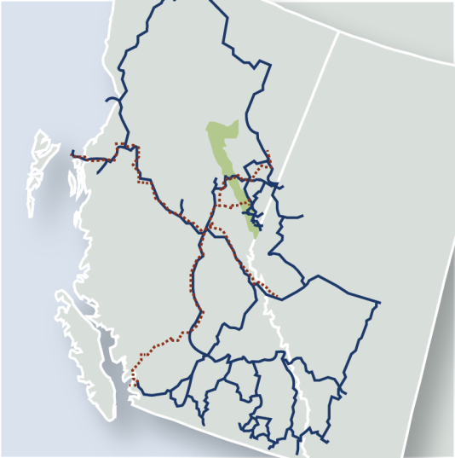
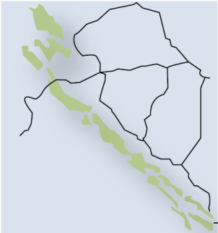
Overview and Capitalization
Company Overview: Colonial Coal
Company Overview
Capitalization and Share Price Chart
  Colonial Coal International Corp. is a pure-play metallurgical coal development company
  Owns 100% interest in 2 resource-stage coal projects in the Peace River Coalfield of northeastern British Columbia
  Chairman and CEO David Austin co-built Western Coal, which was sold to Walter Energy for $3.3 billion in 2010
  277.7 Mt of Measured & Indicated plus 119.2 Mt of Inferred resources of coking coal on the Huguenot property
  Targeting annual production of 3 – 5 Mt per annum from Huguenot
  Great exploration upside in the region and strategically positioned to key infrastructure for Asian export market
Dawson
Creek
ALBERTA
Chetwynd
Prince Rupert
Fort Nelson
Flatbed
Tumbler
Ridge
Huguenot
Flatbed
BRITISH
COLUMBIA
Huguenot
Project
Coal Fields
City
CN Rail
Roads
Key
Neptune Terminals
Vancouver
Westshore Terminals

Slide 9
Experienced Management and Board
Company Overview: Colonial Coal
Management Team and Board of Directors
David Austin Chairman, President & CEO | Co-founder of Western Coal, NEMI and now CCIC 1 of 3 founders credited for taking Western Coal to production; Sold to Walter Energy for C$3.3 billion in 2010 Also credited for the exploration/development success and sale of Northern Energy and Mining Inc. (NEMI) to Anglo America for +$400mm
William Filtness CFO | Over 29 years experience as a director or officer of mining companies Former director of Lions Gate Metals Inc. and former CFO of Sprott Resources, South American Silver, and NEMI
John Perry COO & Director | Over 40 years experience as a geologist (over 35 years as a consultant): worked on many coal projects in northeastern BC, both as a consulting geologist and in senior corporate exploration management.
Wayne Walters Director | Geological consultant and former director of Running Fox Resources and NEMI
Tony Hammond Director | Chairman and MD of Great Orme Mines and a former director of NEMI
Ian Downie Director | Professional negotiator with an established mediation and dispute resolution consulting company

Slide 10
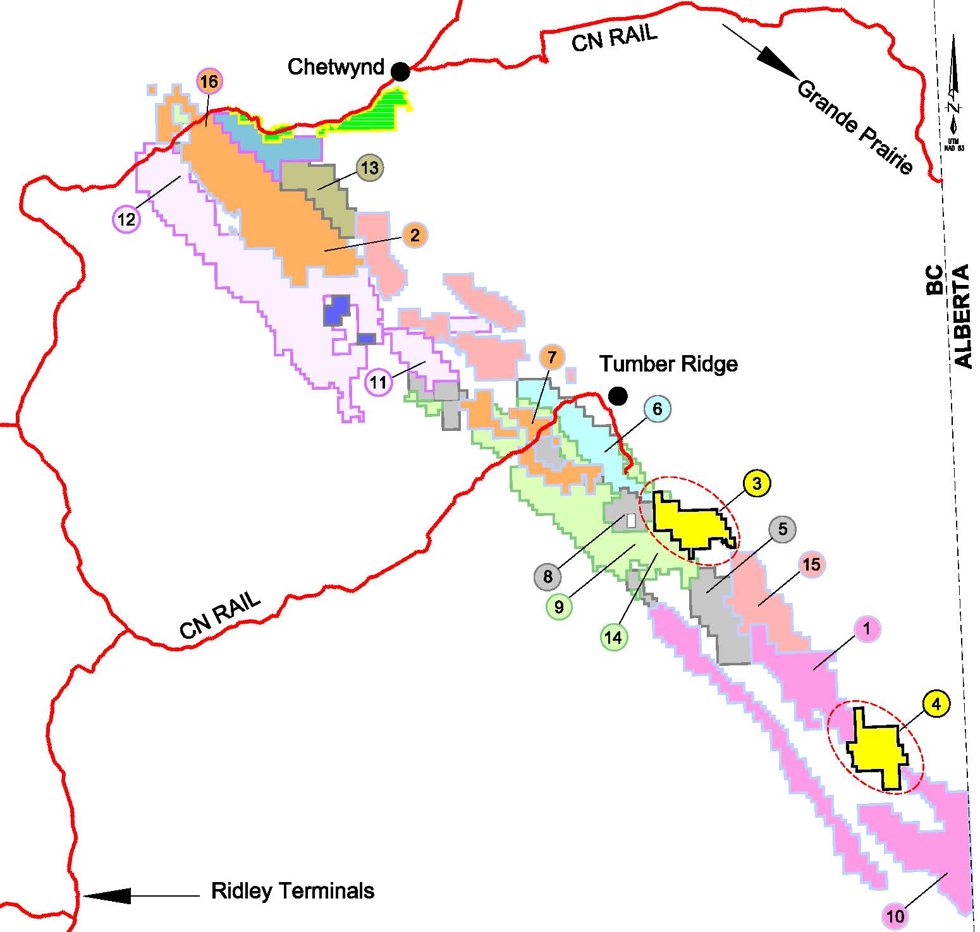
Peace River Coalfield
Belcourt (Walter / PRC (Anglo))
Reserves : 57.00 Mt
Resources: 171.2 Mt
Target Production: 4 Mtpa
Roman ( PRC (Anglo) ) – C&M
Reserves : 25.8 Mt
Resources: 6.5 Mt
Target Production: 2-4 Mtpa
1
9
Brule (Conuma) - Producer
Reserves: 16.6 Mt
Resources: 28.0 Mt
Target Production 1-2.0 Mtpa
Saxon ( Walter / PRC (Anglo) )
Historical “Reserves” : 76 Mt
Resources:
2
10
Flatbed (Colonial Coal)
Target Resources: 100+ Mt
Target Production: 2-4 Mtpa
Sukunka (Glencore)
Resources: 185 Mt
Target Production: 3 Mtpa
3
11
Huguenot (Colonial Coal)
Resources: 397 Mt
Target Production: 3.5-5.0 Mtpa
Suska (Glencore / Boreas)
Resources: 103 Mt
4
12
Mt. Duke (Teck)
Historical “Reserves”: 281 Mt
Trefi ( Trefi )
Historical Resources: 90 Mt
5
13
Murray River (HD Intl. Mining)
Resources: 688 Mt
Target Production: 4.8 Mtpa
Trend ( PRC (Anglo) ) – C&M
Reserves : 8.3 Mt
Resources: 29.1 Mt
Target Production: 1.7 Mtpa
6
14
Perry Creek (Conuma)-C&M
Reserves : 8.8 Mt
Resources: 28 Mt
Target Production: 1.5 Mtpa
Wapiti (Canadian Dehua)
Projected Resources: 7000 Mt
Target Production: 6 Mtpa
7
15
Quintette (Teck) –Mt. Babcock
Reserves : 38.1 Mt
Resources: 236.2 Mt
Target Production: 3-4 Mtpa
Willow Creek (Conuma)-C&M
Reserves : 16.6 Mt
Target Production: 1.7 Mtpa
8
16
Note:
C&M – Care and Maintenance
December 15, 2016

Slide 11
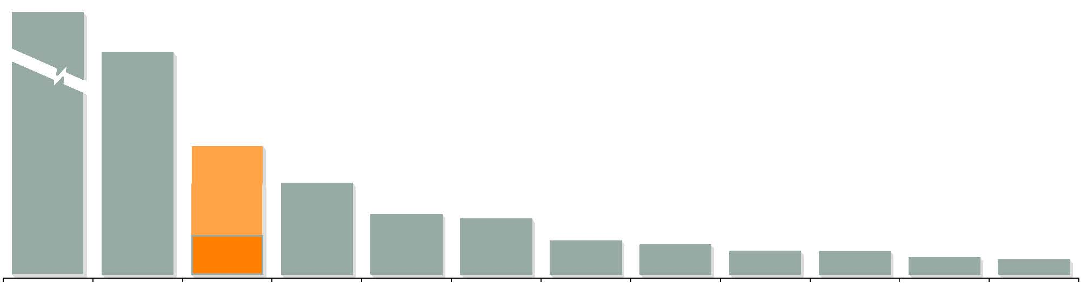
Huguenot Asset: One of the Largest Hard Coking Coal Deposits in the Region
Company Overview: Colonial Coal
  Huguenot has a contained resource of 277.7 million tonnes of combined Measured and Indicated resources plus 119.2 million tonnes of Inferred resources, making it one of the largest deposits in the region
  Huguenot's metallurgical coal quality ranks as a premium metallurgical coking coal product
  Contains low sulfur and low phosphorus
  Similar coal quality to Anglo's nearby Trend mine (premium product exported to Asia)
7,000
688
278
(M+I)
281
185
171
103
90
70
70
51
119
(Inf.)
45
Canadian Dehua
(Wapiti)
HD International
(Murray River)
Colonial Coal
(Huguenot)
Teck
(Mt. Duke)
Glencore &
JX Nippon
(Sukunka)
Walter /
PRC (Anglo)
(Belcourt)
Glencore &
JX Nippon
(Suska)
Anglo Pacific
(Trefi)
Conuma
(Wolverine)
PRC (Anglo)
(Trend)
Conuma
(Willow Creek)
Conuma
(Brule)

Slide 12
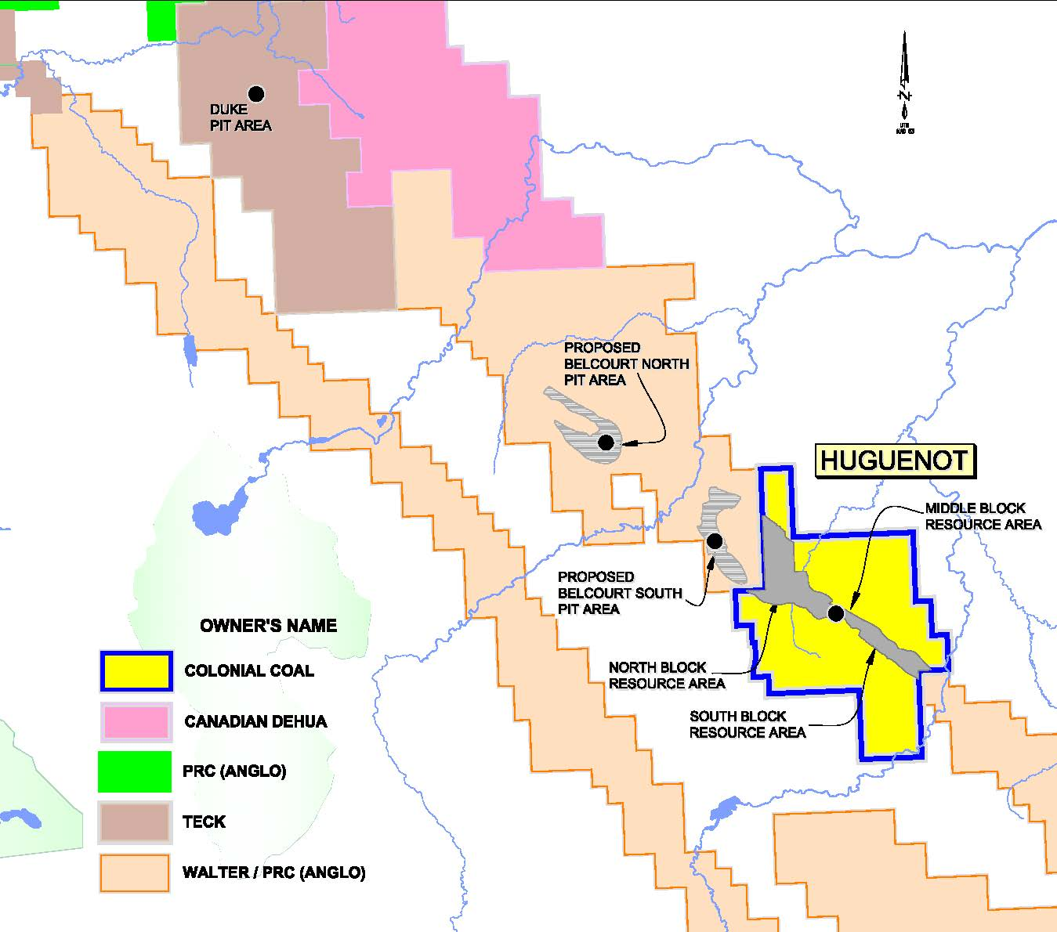
Huguenot Project Overview (100% Interest)
Company Overview: Colonial Coal
Project Location
Project Summary
Located adjacent to the proposed Belcourt South open pit (owned by Belcourt Saxon Coal Ltd. – Anglo/Walter JV)
  Similar coal characteristics
Amenable to open pit and underground mining
1.5% royalty FOB port
Located ~120 road-km from Quintette and PRC load-outs
Requires an 85 km rail (or combination of a rail and overland conveyor) to link with existing rail line as per Colonial Coal’s PEA
Proposed production of clean coal from combined surface and underground mining operations averages approximately 3Mtpa, and ranges from 1.4 Mtpa to 5.9 Mtpa over 31 year LOM

Slide 13
Huguenot – Premium Coking Coal Characteristics
Company Overview: Colonial Coal
Premium clean coal product with low ash, low sulfur, low phosphorus, and High FSI
Weight averaged theoretical yield of 74%
Clean Coal Quality Summary (dry basis)
Seam |  | Ash % | VM % | FC % | S % | FSI | % P (in coal) | Theoretical Yield % | % RoMax
10 |  | 8.58 | 27.22 | 64.20 | 0.93 | 8.0 | 0.187 | 67.93 | 1.06
9 |  | 7.49 | 26.82 | 65.69 | 0.83 | 7.6 | 0.106 | 74.85 | 1.05
8 |  | 7.76 | 26.20 | 66.04 | 0.51 | 6.4 | 0.034 | 66.76 | 1.07
6D |  | 5.03 | 25.87 | 69.10 | 0.84 | 7.3 | 0.043 | 59.94 | 1.13
6B |  | 6.82 | 24.78 | 68.40 | 0.50 | 6.7 | 0.084 | 70.37 | 1.12
6L |  | 7.97 | 23.23 | 68.80 | 0.48 | 6.7 | 0.091 | 63.71 | 1.19
5 |  | 7.90 | 23.68 | 68.41 | 0.34 | 6.5 | 0.034 | 81.84 | 1.19
4U |  | 5.11 | 23.70 | 71.19 | 0.73 | 7.4 | 0.093 | 91.93 | 1.19
4 |  | 5.63 | 22.91 | 71.46 | 0.61 | 7.5 | 0.030 | 86.81 | 1.28
3D |  | 4.97 | 27.82 | 67.21 | 1.21 | 9.0 | 0.098 | 76.66 | 1.16
3B/3BL |  | 8.74 | 23.07 | 68.19 | 0.51 | 7.7 | 0.029 | 57.01 | 1.24
2EF |  | 9.15 | 22.43 | 68.42 | 0.41 | 8.0 | 0.158 | 51.34 | 1.24
2A |  | 8.02 | 24.95 | 67.03 | 1.04 | 9.0 | 0.017 | 65.27 | 1.22
2Z |  | 8.56 | 22.34 | 69.09 | 0.46 | 8.2 | 0.067 | 44.36 | 1.31
1 |  | 7.86 | 22.57 | 69.57 | 0.39 | 6.5 | 0.027 | 90.85 | 1.22

Slide 14
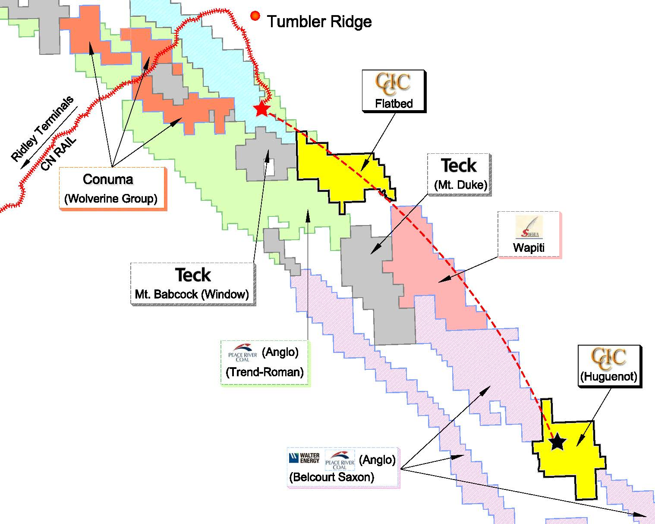
Strategic Location With Significant Partnership Opportunities
Sharing in the development of joint infrastructure (roads / rail) with other potential operators in the region would lower initial capital costs at Huguenot
  PEA contemplates a third party built railway used by other potential producers in the region
  85 km rail spur (+/- overland conveyor) to connect the project to the existing main rail line
If not built by an independent third party, the railway could be constructed on a shared basis with other coal producers and rail providers in the region.
  Huguenot is adjacent to the Belcourt Project (Anglo American / Walter Energy)
  Other nearby properties are owned by Teck Resources, Canadian Dehua, and Anglo American
Rail access by other projects would reduce costs and provide practical benefits
  Development / operating costs would be distributed across all operators in the region for greater scale and lower per tonne cost
  While rail is the preferred mode of transportation in the region, trucking coal is viable but more expensive on a per tonne basis
Potential to Jointly Develop Shared Infrastructure

Slide 15
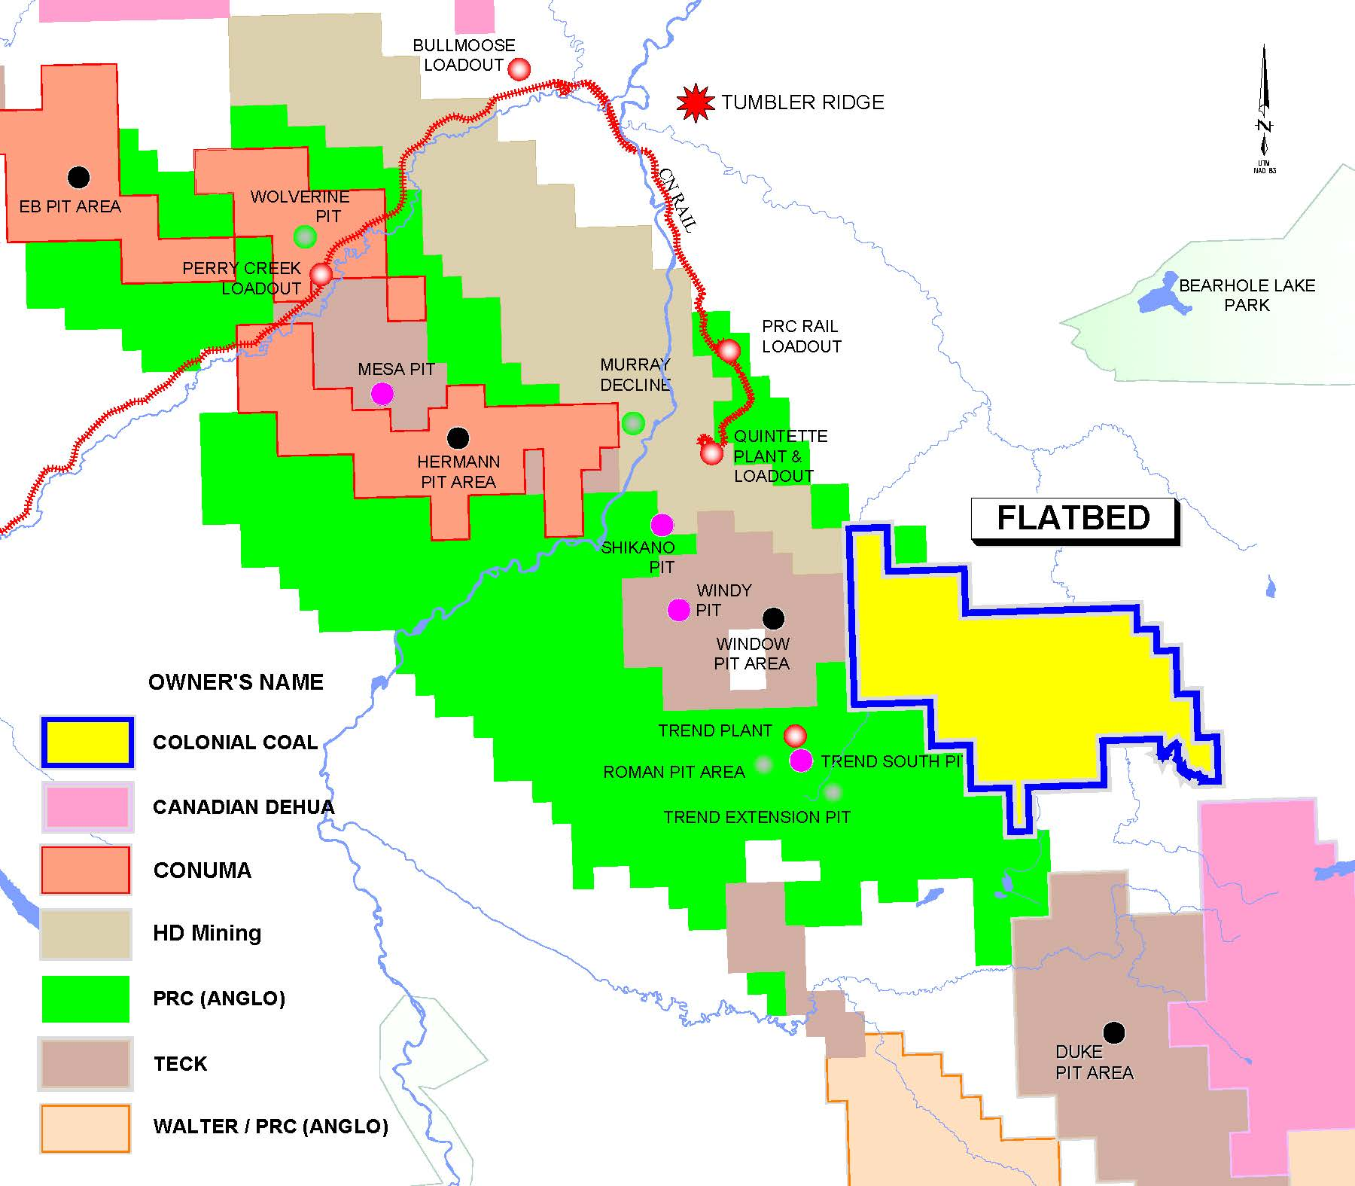
Flatbed Project Overview (100% Interest)
Company Overview: Colonial Coal
Flatbed will be the Company’s primary focus in 2017
Project Location
Project Summary
Property adjacent to Trend and Quintette mines
Potential for large tonnage deposit
  100+ Mt coking coal resource target
Property located 15 Km from Quintette load out
Potential for a 3rd pipeline crossing of Rocky Mountains to bring further infrastructure into the area of the property
Trend Plant
Roman Pit Area
Trend South
Trend Extension Pit

Slide 16
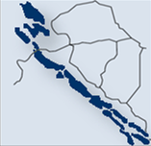
Available Rail and Port Capacity to Access Export Markets
Company Overview: Colonial Coal
Production from Huguenot would be shipped by rail to export terminals on the west coast of British Columbia
Rail lines out of the Peace River Coalfield are operated by a Class I Canadian carrier (CN Rail, largest railway company in Canada) and have available capacity to support future production from Huguenot
  Coal is hauled by rail approximately 1,000 km to the Ridley Terminal in Prince Rupert
The Ridley Terminal is a deep water port with a total coal capacity of 30 mtpa (expansion completed 2014)
  One of the deepest, ice free natural harbours in the world
  100% owned by the Government of Canada
  Capable of supporting capesize vessels (250,000 DWT)
Canada
Dawson
Creek
Chetwynd
AB
Peace River
Coalfield
Tumbler
Ridge
Flatbed
85 km from rail load-out facility
Huguenot
Flatbed
Huguenot
Infrastructure
Coal Rank
Port Facility / Coal Terminal
CN Railway
CP Railway
Bituminous
Sub-bituminous
Lignite

Slide 17
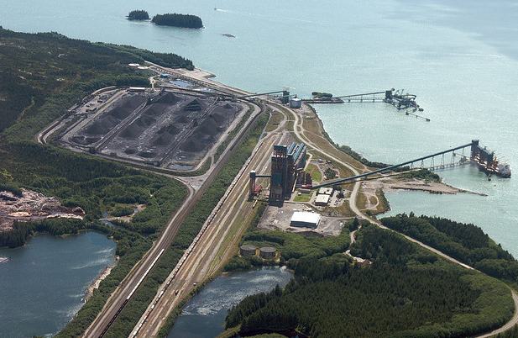
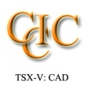





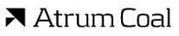



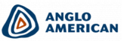

World Class Infrastructure
Company Overview: Colonial Coal
Extensive Regional Infrastructure
Unencumbered Access to Export Markets
HAY RIVER
CN Rail provides access to Ridley Terminals
Deep-water coal loading facilities at Ridley Terminals
  Current capacity 30 Mtpa
  Recent Modification Project to increase capacity to 30 Mtpa
  No port or rail capacity constraints
FORT NELSON
Ridley Terminals
ALBERTA
SASKATCHEWAN
PRINCE
RUPERT
FORT MCMURRAY
PRINCE
GEORGE
BRITISH
COLUMBIA
EDMONTON
CALGARY
SASKATOON
Neptune Terminals
VANCOUVER
REGINA
Westshore Terminals
Infrastructure
Coal Rank
Port Facility / Coal Terminal
CN Railway
CP Railway
Bituminous
Sub-bituminous
Lignite
Western Canadian Coal Companies

Slide 18
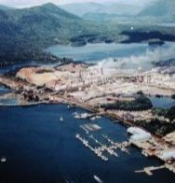
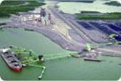
Investment Upside: Watson Island
Company Overview: Colonial Coal
Tsimpsian
Peninsula
Tuck Inlet
In 2012, Colonial Coal through its subsidiary Watson Island Development Corp. (Watco) entered into a MoU with Lax Kw’alaams Band and Metlakatla First Nations (“Coast Tsimshian Nation”) for the formation of a JV for the potential acquisition of the Watson Island.
The Coast Tsimshian Nation have an exclusive arrangement (“Exclusivity Agreement”) with the City of Prince Rupert to purchase Watson Island.
  Watco will compensate the City of Prince Rupert for actual land expenses in accordance with the terms of the Exclusivity Agreement
  Watco has undertaken a feasibility investigation in relation to the development of the Watson Island.
  Watson Island is envisioned as a multi-product bulk commodity port and offers a potential and exciting solution to expand coal export capacity in British Columbia in light of increasing regional coal production
  Watco is currently in litigation with the City of Prince Rupert in connection with the acquisition of Watson Island.
Prince Rupert
Airport
Prince Rupert
Kaien
Island
Digby
Island
Fairview Terminal
Proposed Expansion
CN Rail
To Prince George 724 km
To Edmonton 1,461 km
To Vancouver 1,502 km
3
Prince Rupert Grain
1
Watson Island
Ridley Terminals (Coal)
2
Ridley
Island
Port Edward
Kinahan
Islands
Smith Island
  Ridley Terminal’s initial throughput capacity of 12 Mtpa
1
  Expansion of Ridley Terminals to 30 Mtpa now complete
2
  Potential site for establishment of a bulk terminal on Watson Island
3

Slide 19
Market Overview: Metallurgical Coal
Company Overview: Colonial Coal
Summary: Investment Highlights

Slide 20
Unparalleled Investment Opportunity
Summary: Investment Highlights
Invest in one of the largest deposits of premium quality hard coking coal in western Canada
  The only Canadian listed, publicly traded pure-play coking coal company in western Canada
  Targeted open pit and underground mineable resource of approximately 400 Mt at Huguenot Project (“Huguenot”)
  Potential for large tonnage deposit at Flatbed Project (“Flatbed”) in proximity to Trend and Quintette mines
The only junior coal company in western Canada to have a stake in a port development project
  Recent MoU regarding potential development of port facility at Watson Island
Gain exposure to one of the most active coal basins in a mining friendly jurisdiction with excellent infrastructure in place
  Recent acquisitions by Walter Energy (“Walter”), Anglo American (“Anglo”), Glencore, and Winsway/Marubeni amongst others and Conuma
  Capacity expanded at western Canadian coal ports
Strategically located coal properties adjacent to major projects provide logical buyer and partnership opportunities
  Huguenot located between Anglo’s and Walter’s Belcourt Saxon JV project areas
  Flatbed located adjacent to Anglo’s Trend mine (currently under care and maintenance) and Teck’s proposed Window open pit (Mt. Babcock, Quintette)
Highly experienced management team with a proven track record in the Peace River Coalfield
  Highly capable management team with significant prior experience advancing other development projects to production in the region
Provides exposure to long-term Asian growth story whilst staying invested in a safe jurisdiction
  Increasing demand for high quality coking coal driven by long-term Asian growth
  Western Canadian coal projects have cost-advantaged access to East Asian markets

